Slide 1


Sophie FamilyName
Dec 1, 2023

Slide 2

Outline
Executive Summary
Introduction
Methodology
Results
Conclusion
Appendix

Slide 3
Executive Summary
Goal:
To use data science to find a method in predicting if the first stage of the SpaceX Falcon 9 will land successfully
Summary of methodologies:
After collected from internet, the data will be processed, explored. Several models will be applied to identify the best one for future usage.
Summary of all results
Based on the accuracy score of the testing data, the logistic regression model fits our purpose the best.

Slide 4
Introduction
Project background and context
SpaceX advertises Falcon 9 rocket launches on its website with a cost of 62 million dollars; other providers cost upward of 165 million dollars each, much of the savings is because SpaceX can reuse the first stage. Therefore if we can determine if the first stage will land, we can determine the cost of a launch.
Problems you want to find answers
If the data is available
What information it contains
How it should be pre-processed
What models can be applied
Which model is the best based on eveluation

Slide 5

Section 1

Slide 6
Methodology
Executive Summary
Data collection methodology:
Data is collected from www.spacexdata.com and www.wikipidia.org
Perform data wrangling
A binary variable is created to reflect if the landing is sucessful.
Perform exploratory data analysis (EDA) using visualization and SQL
Perform interactive visual analytics using Folium and Plotly Dash
Perform predictive analysis using classification models
Python's machine learning power provides a simple way to pre-process, normalize, slice the data and apply models to it. With the scores calculated automatically, the best model will be selected for application.

Slide 7
Data Collection
Data were collected through the following steps in brief:
Request to the SpaceX API
Clean the requested data
Extract a Falcon 9 launch records HTML table from Wikipedia
Parse the table and convert it into a Pandas data frame

Slide 8
Data Collection – SpaceX API
Please refer to the code in Githut for detail of the data collection step.
testrepro/wk1-jupyter-labs-spacex-data-collection-api .ipynb at main · zswlx/testrepro (github.com)

Slide 9
Data Collection - Scraping
Please refer to the code in Githut for detail of the data Scraping step.
testrepro/wk1-jupyter-labs-webscraping.ipynb at main · zswlx/testrepro (github.com)

Slide 10
Data Wrangling
Please refer to the code in Githut for detail of the data Wrangling step.
testrepro/wk1-labs-jupyter-spacex-Data wrangling.ipynb at main · zswlx/testrepro (github.com)

Slide 11
EDA with Data Visualization
Please refer to the code in Githut for detail of the data Visualization step.
testrepro/wk2-jupyter-labs-eda-dataviz.ipynb.jupyterlite.ipynb at main · zswlx/testrepro (github.com)

Slide 12
EDA with SQL
Using bullet point format, summarize the SQL queries you performed
testrepro/wk2-jupyter-labs-eda-sql-coursera_sqllite.ipynb at main · zswlx/testrepro (github.com)

Slide 13
Build an Interactive Map with Folium
Summarize what map objects such as markers, circles, lines, etc. you created and added to a folium map
Explain why you added those objects
testrepro/wk3-lab_jupyter_launch_site_location.jupyterlite.ipynb at main · zswlx/testrepro (github.com)

Slide 14
Build a Dashboard with Plotly Dash
Summarize what plots/graphs and interactions you have added to a dashboard
Explain why you added those plots and interactions
testrepro/wk3-spacex_dash_app.py at main · zswlx/testrepro (github.com)

Slide 15
Predictive Analysis (Classification)
Summarize how you built, evaluated, improved, and found the best performing classification model
You need present your model development process using key phrases and flowchart
testrepro/wk4-SpaceX_Machine_Learning_Prediction_Part_5.jupyterlite (1).ipynb at main · zswlx/testrepro (github.com)

Slide 16
Results
Exploratory data analysis results
Interactive analytics demo in screenshots
Predictive analysis results

Slide 17

Section 2

Slide 18
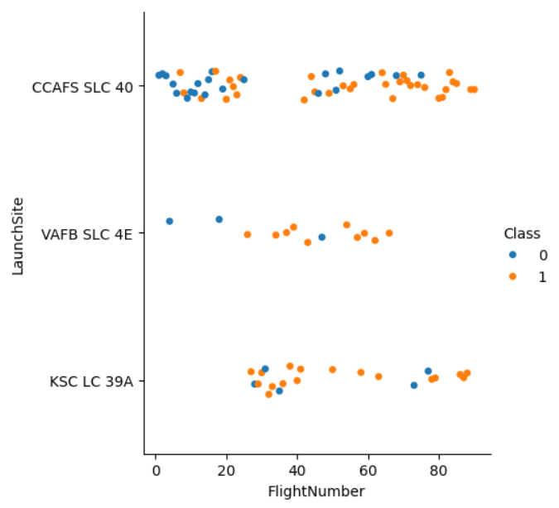
Flight Number vs. Launch Site

Slide 19
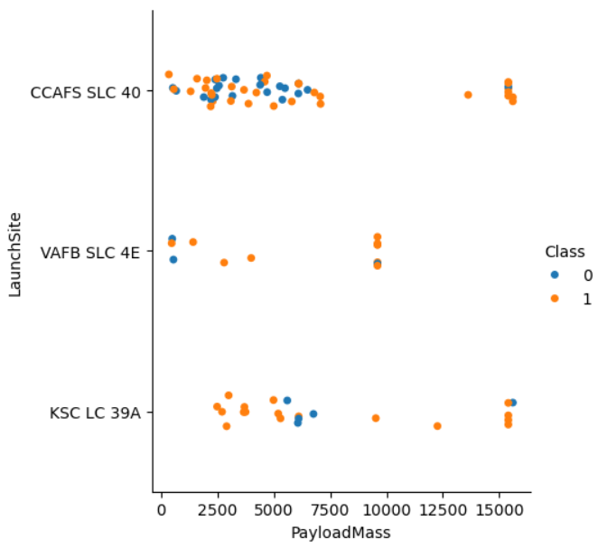
Payload vs. Launch Site

Slide 20
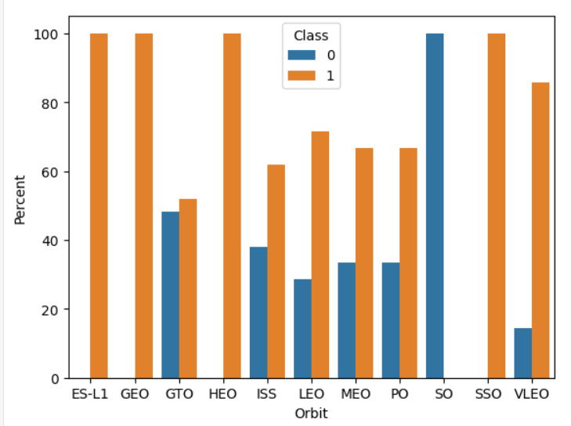
Success Rate vs. Orbit Type

Slide 21
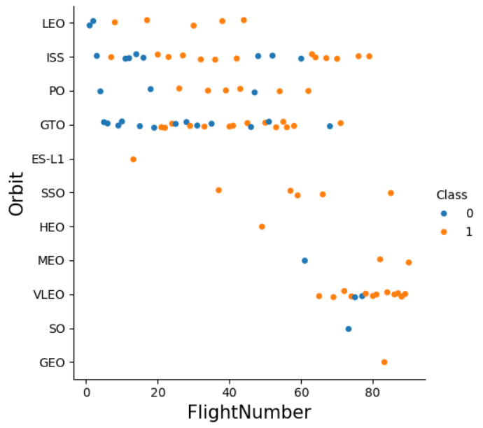
Flight Number vs. Orbit Type

Slide 22
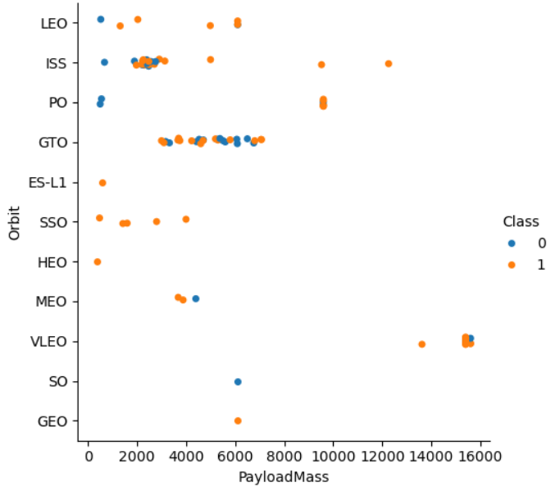
Payload vs. Orbit Type

Slide 23
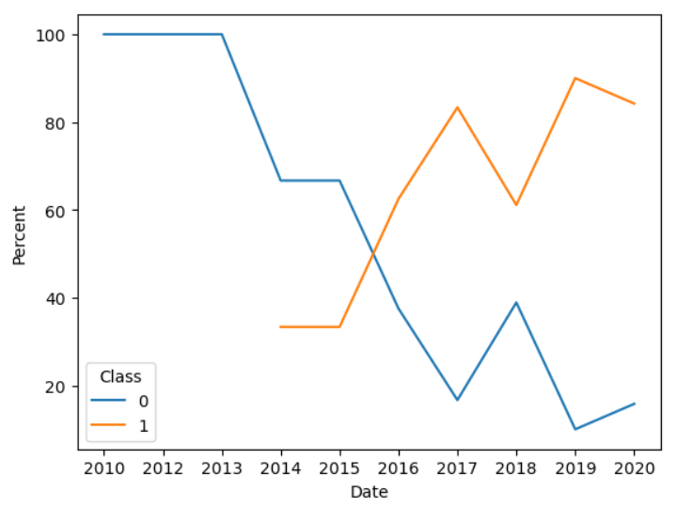
Launch Success Yearly Trend

Slide 24
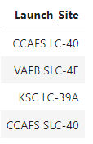
All Launch Site Names
Four Launch Sites were identified from the data, as in the right figure

Slide 25
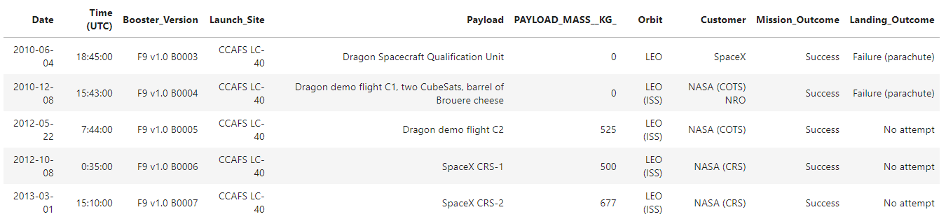
Launch Site Names Begin with 'CCA'
5 records where launch sites begin with `CCA` are illustrated as below

Slide 26
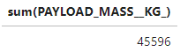
Total Payload Mass
As of the data ends date, the total payload carried by boosters from NASA is as follow:

Slide 27
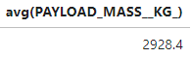
Average Payload Mass by F9 v1.1
As of the data ends date, the average payload mass carried by booster version F9 v1.1 is

Slide 28
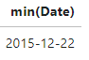
First Successful Ground Landing Date
The dates of the first successful landing outcome on ground pad is:

Slide 29
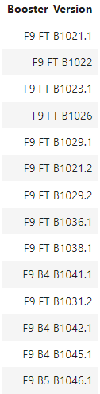
Successful Drone Ship Landing with Payload between 4000 and 6000
The right list shows the names of boosters which have successfully landed on drone ship and had payload mass greater than 4000 but less than 6000

Slide 30
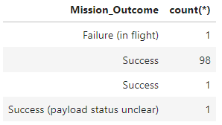
Total Number of Successful and Failure Mission Outcomes
A summary of the total number of successful and failure mission outcomes is as follow

Slide 31
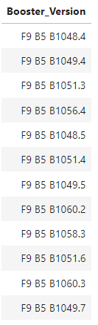
Boosters Carried Maximum Payload
You will find the names of the booster which have carried the maximum payload mass from the list here:

Slide 32
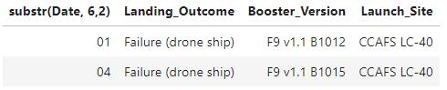
2015 Launch Records
In year 2015, there were two the failed landing_outcomes in drone ship, with their booster versions and launch site names

Slide 33
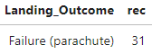
Rank Landing Outcomes Between 2010-06-04 and 2017-03-20
The rank of the count of landing outcomes (such as Failure (drone ship) or Success (ground pad)) between the date 2010-06-04 and 2017-03-20, in descending order

Slide 34

Section 3

Slide 35
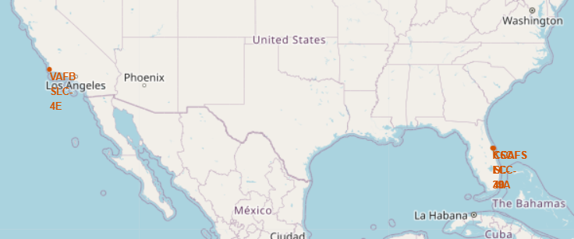
Launch Site Locations
Four Launch sites, as shown in the map, were located across US with one on the west coast, and three on the east coast.

Slide 36
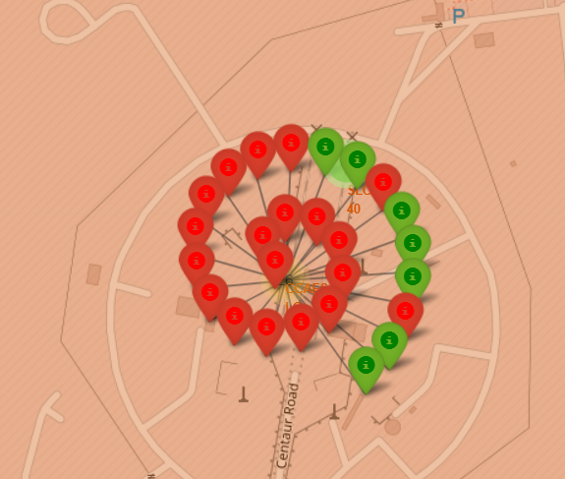
Launch Attempts
CCAFS LC-40 launched the most rockets, but the success rate is not the highest. The number of babbles represents the attempts, with successes in green, and failures in red.

Slide 37
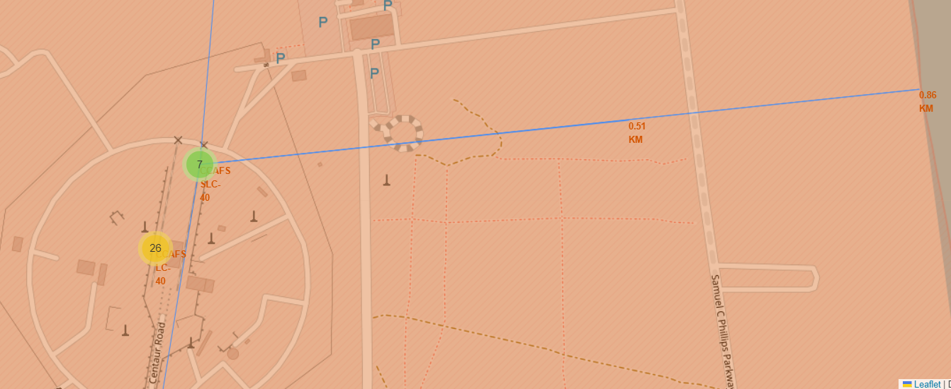
Access to Transportation
Transportation accounts for a certain portion of the total cost, easy access to sea coast is one of the elements considered.

Slide 38

Section 4

Slide 39
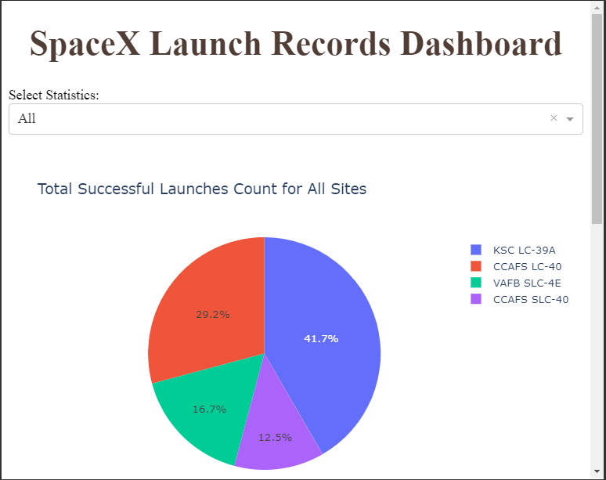
Success Rates for All Sites
The pie chart gives an clear picture of the share of success launches for each of the site over years.

Slide 40
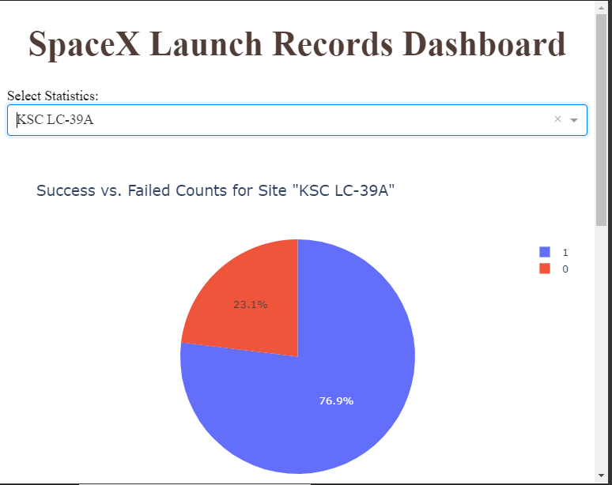
Details on KSC LC-39A
KSC LC-39A has the highest success rate in launchings.

Slide 41
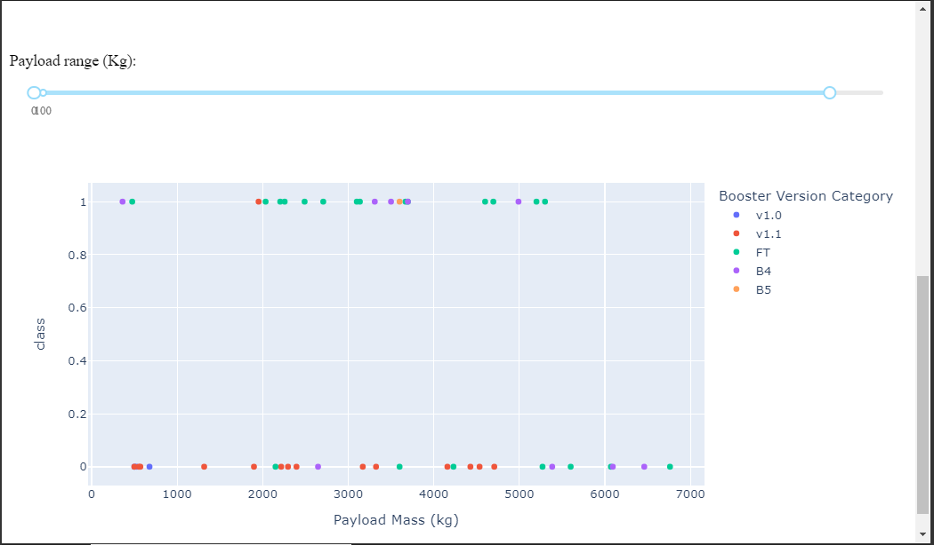
Launch Outcome
The relation between Booster version and Payload Mass is illustrated in the right. Spaceships with a mass ranging from 2000 to 3600 KG and around 5000 KG seem to perform well.

Slide 42

Section 5

Slide 43
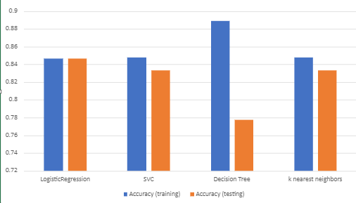
Classification Accuracy
The bar chart illustrates Logistic Regression bares the highest accuracy for testing, though its training score is not the best. On the contrary, Decision Tree does poorly on testing, with the top training score.

Slide 44
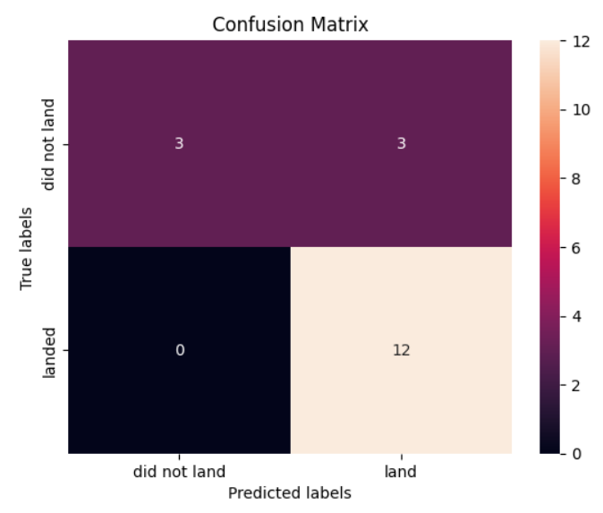
Confusion Matrix
The confusion Matrix on the right shows how the logistic regression model behaves when predicting successful landings. Out of 18 testing landing records, it correctly predicted 12 successful ones and all three failures. It did wrongly labeled three successful landings as failed.

Slide 45
Conclusions
The payload mass is an element closely related to the success of landing
Over the years, the success rates are getting higher with more experience was accumulated
It is possible to predict if a landing will success from the studied model with an accuracy of 84%

Slide 46
Appendix
Please note the datasets used for portion of the analysis might be different on format, and getting familiar with each dataset is critical in conducting effective analysis.

Slide 47


